Slide 1
Presentation and Analysis of Business Data
Denco Corp
SRI CHANDANA GUNDI
siri.chandana315@gmail.com
7799809929

Slide 2
AGENDA
Analysis on product
Understanding business Revenue
Analyzing Behavior of customers
Business profit margins

Slide 3
Understanding business Revenue
Derivative fields:
Revenue split – By Region
Customers contributions in Revenue
Revenue split – By Product

Slide 4
Revenue split - By Region
 | REGION | REVENUE | MARGIN | TOTAL NO. OF CUSTOMERS
0 | 01-East | 1.250972e+08 | 69726290.83 | 699
1 | 02-Central | 9.464574e+07 | 50584976.32 | 591
2 | 07-Canada Direct | 1.374916e+07 | 6750554.36 | 47
3 | 9x-Export | 2.543275e+06 | 1296015.33 | 45
4 | 05-House | 1.867188e+06 | 819927.94 | 1
5 | 09-China | 2.332946e+04 | 5953.33 | 2
Highest Revenue and margin.
More number of customers
Lowest Revenue and margin.
Less number of customers

Slide 5
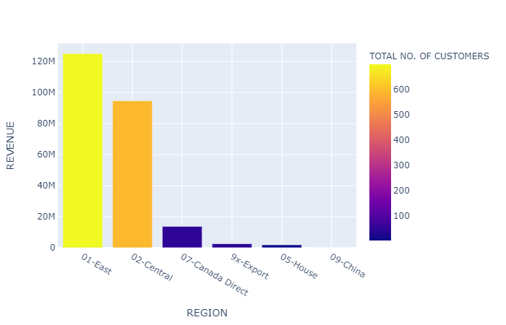
Visualization of Revenue split - By Region
Denco Corp has received highest revenue of more than 120 Million from East region with more number of customers.
Second highest is from Central region in contributing to Denco Corp revenue
Region with more number customers has more revenue and vice versa.

Slide 6
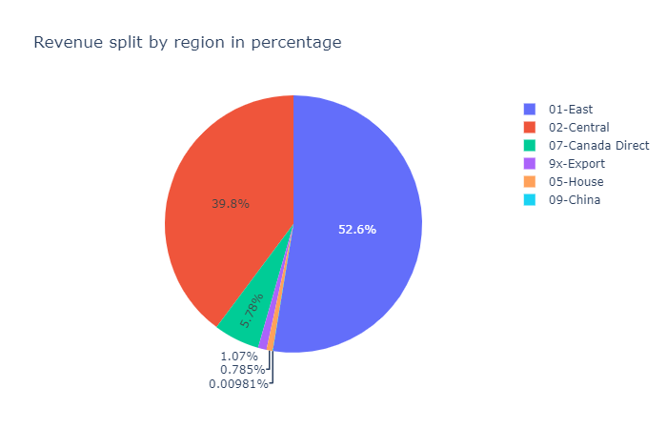
Revenue split percentage - By Region
As more than 50% of Revenue is from East Region and very less from House Region.
40% of Revenue is contributed by Central Region.
To increase the Revenue we should encourage the customers to contribute more by giving some benefits etc.
It is more important to increase the customers initially where there are less number of customers to buy the products.

Slide 7
Analysis on product contribution
Derivative fields:
Product contributing more to their revenue.
Products which has highest margin.
Visualizing on products which has highest revenue and margin with their proportions using pie chart.
Visualizing top 10 products with it’s total number of customers

Slide 8
Analysis on product contribution
 | PRODUCT NUMBER | TOTAL REVENUE | TOTAL MARGIN | TOTAL REGIONS | TOTAL CUSTOMERS | AVERAGE MARGIN PERC
 | 735602000 | 16151536.25 | 10543453.82 | 4 | 88 | 67.510204
 | 764821000 | 6481616.55 | 4022430.49 | 4 | 114 | 75.778689
 | 764901000 | 4258342.73 | 2419071.63 | 5 | 85 | 69.406593
 | 764521000 | 2768182.60 | 1666693.64 | 4 | 91 | 72.559140
 | 735602110 | 2575975.80 | 1660109.27 | 3 | 47 | 64.795918
 | 766121000 | 2013406.60 | 1265261.64 | 3 | 66 | 72.972603
 | 768221000 | 1429982.80 | 864079.71 | 3 | 31 | 66.909091
 | 764822000 | 1290574.10 | 870076.53 | 4 | 50 | 70.509804
 | 764781040 | 1275086.40 | 588640.51 | 3 | 31 | 65.774194
 | 734990000 | 1258279.28 | 934093.73 | 4 | 47 | 78.734694
 | 727000140 | 1196597.44 | 814177.16 | 3 | 55 | 78.456140
 | 764601000 | 1069229.91 | 641272.42 | 4 | 50 | 68.148148
DATA EXPLAINS
REVENUE:
More than 1 Million contributed from these products to their revenue.
CUSTOMERS:
More than 20 customers bought these products.
MARGIN PERC:
On an average more 50% of margin generated from the listed products.

Slide 9
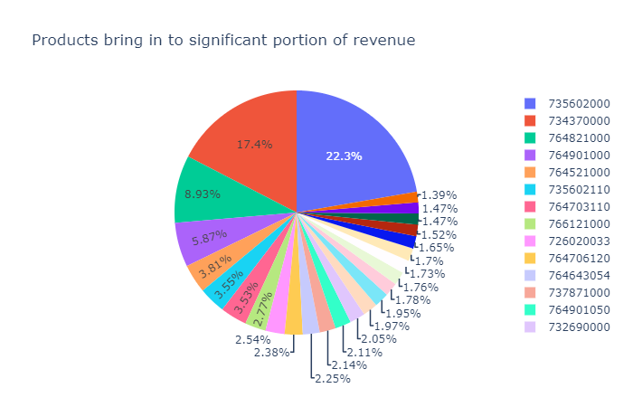
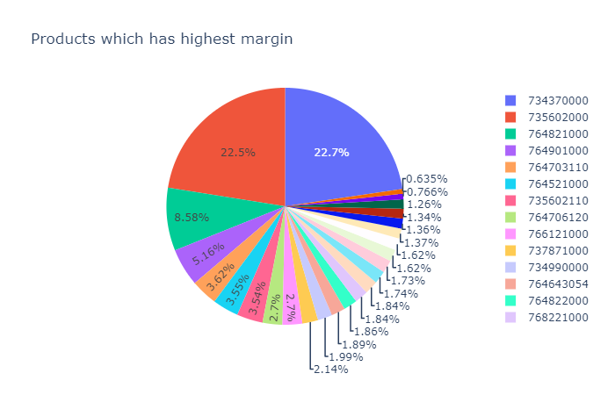
Visualizing on products which has highest revenue and margin with their proportions using pie chart
Pie chart explain about the margin of products with their proportions.
735602000 Partnum has profited more than all the products.
Pie chart explain about products contributed more in their revenue
735602000 contributed more than all products to their revenue

Slide 10
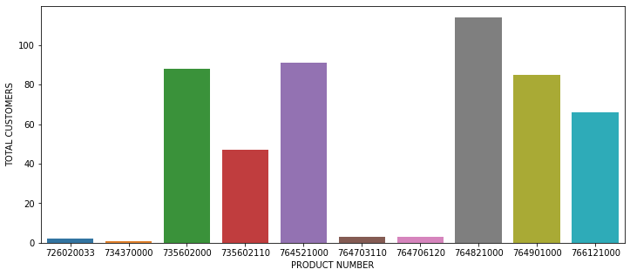
Visualizing top 10 products with it’s total number of customers
Product bought by more customers

Slide 11
Analyzing Behavior of customers
Derivative fields:
Customers who has contributed more to their revenue with highest margin
Customers bought more products
Customers in more regions
Loyal Customers

Slide 12
Customers who has contributed more to their revenue
with highest margin
 | CUSTNAME | REVENUE | MARGIN
0 | TRIUMPH INSULATION | 35592531.24 | 12971524.63
1 | CORNING SHARED SERVICES | 12843518.78 | 10766305.54
2 | THERMAL PRODUCTS INC | 7209418.18 | 4449739.59
3 | WESTERN INDUSTRIAL CERAMI | 5589784.96 | 2813300.85
4 | DELTA REFRACTORIES | 5546115.08 | 3402966.02
5 | INDUSTRIAL FURNACE CO | 5530092.06 | 3561703.00
6 | PYROTEK INC | 5108886.59 | 2792387.30
7 | REX ROTO CORP | 4956097.43 | 1539106.08
8 | BRYANT REFRACTORY CO. | 4785301.55 | 2188070.92
9 | BAY INDUSTRIES INC. | 4559682.73 | 2961437.15
Top 10 Customers with highest revenue and margin

Slide 13
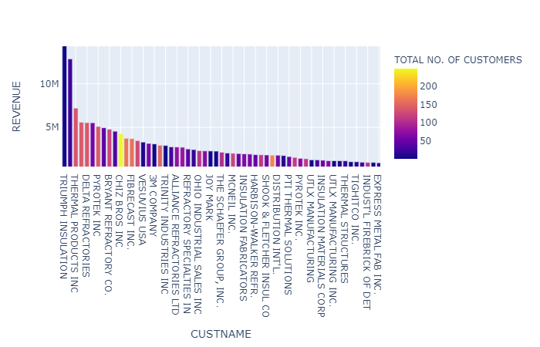
Visualizing customers who has contributed more with more profit to the company

Slide 14
Customers bought more products
 | CUSTNAME | TOTAL PRODUCTS
0 | CHIZ BROS INC | 247
1 | ARMIL / C F S INC | 174
2 | ZAR-TECH | 163
3 | FIBRECAST INC. | 159
4 | REFRACTORY ENGINEERS INC. | 150
5 | PYROTEK INC | 141
6 | WESTERN INDUSTRIAL CERAMI | 141
7 | DELTA REFRACTORIES | 139
8 | THERMAL PRODUCTS INC | 136
9 | RHI CANADA INC. | 127
TOP 10 CUSTOMERS WHERE
NUM PARTS BOUGHT BY THIS CUSTOMERS

Slide 15
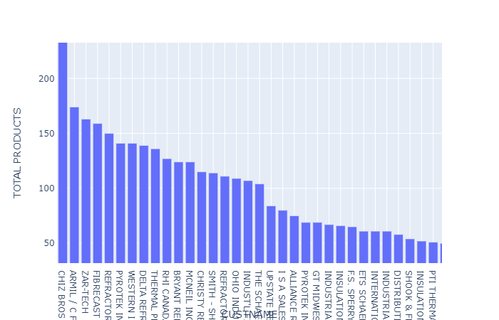
Visualizing customers who bought more products using bar plot

Slide 16
Who are Loyal Customers
REVENUE > 4559682.73
MARGIN > 2961437.15
PRODUCTS > 127
I have given some threshold values to conclude the most loyal customers
 | CUSTNAME | TOTAL REVENUE | TOTAL MARGIN | TOTAL REGIONS | TOTAL PRODUCTS
2 | THERMAL PRODUCTS INC | 7209418.18 | 4449739.59 | 1 | 136
4 | DELTA REFRACTORIES | 5546115.08 | 3402966.02 | 2 | 139

Slide 17
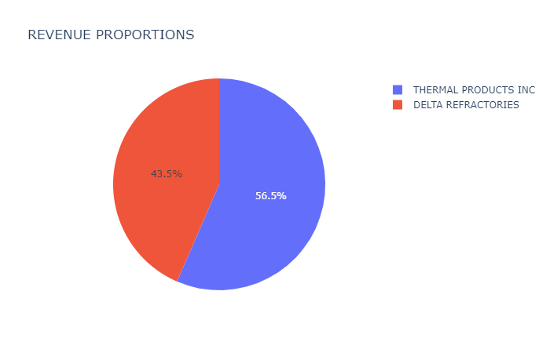

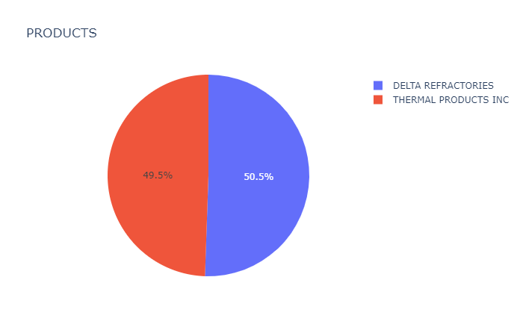

Slide 18
ASSUMPTIONS
Customers which has highest revenue contributions are more profitable.
As the cost of product increases revenue increases
More number products even though cost is less helps in increasing revenue to get more profits
Number of customers increases then the contributing towards revenue increases and can profit with high margins
Less customers from any region company will not get more revenue. Attract customers sell the products

Slide 19
CONCLUSION
I have done all the analysis using python.
I want to conclude that from East and Central regions customers are encouraging Denco corp company in increasing their revenue to earn more profits.
Loyalty of any customer is more important for the growth and consistency of the business as well as company need to make the customers to trust and do business with them.

